Slide 1
6MMCS009W1 Usability Testing & Evaluation
Introduction to the module

Slide 2
Contacts
Sahdiya Hussain
  E-mail: Sahdiya.h@iit.ac.lk
  Room: 6 Floor
  Office hours
    Onsite open hours Wednesdays 1.30 – 2.30 p.m.

Slide 3
Module schedule
48 hours for the semester
  Lecture1, Tuesday 10:30 am to 12:30 pm
  Lecture2, Tuesday 1:30 pm to 3:30 pm
  Tutorials:
Attendance will be tracked.

Slide 4
Module aims
The overall aims of the module are:
  The module provides students with essential skills and practice in a range of usability techniques, how to conduct usability studies and evaluations of a wide range of products or platforms.
  The importance of applied understanding of the different evaluation approaches and the use of experimental design and statistical analysis is illustrated through real-world examples.
  The ability to interpret and critically discuss results is stressed throughout.

Slide 5
Learning Outcomes
Upon successful completion of this module you will be able to:
  LO1 Demonstrate an applied understanding of the role of evaluation in usability context
  LO2 Demonstrate knowledge and understanding in usability testing and evaluations by selecting appropriate methods and techniques in a variety of contexts
  LO3 Plan, organise and conduct appropriate testing and evaluation methods for selected products and systems
  LO4 Apply suitable analytical and/or statistical methods to analysis and interpret results to assess the design
  LO5 Formulate and make recommendations to inform decision making in terms of design and development of the product

Slide 6
Indicative syllabus content
Role of Testing and evaluation in Usability Studies
Defining and comparing usability testing and evaluation; Fitting usability testing and evaluations within a user-centred design process – Lean UX and traditional lifecycles; Usability metrics (such as performance metrics, and preference metrics); Formulating appropriate test objectives and considering validity of usability measures; Comparing types of usability testing (such as, formative and summative testing, and remote and lab-based testing); evaluation methods throughout the development lifecycle. Testing different types of products.
Formulating a real-world enquiry in usability context
Formulating research questions to identify and explore solutions to real-world usability issues; formulating hypotheses for testing.
Organising, planning and conducting studies
Selecting appropriate usability test and evaluation approaches including guerrilla testing, formative evaluation, cognitive walkthroughs; heuristic evaluations, A/B testing and quantitative testing. Considering the testing environment (such as protocols, lab and equipment, testing conditions). Recruiting and screening participants. Setting up user tasks. Defining the roles and tasks of moderator and observer. Piloting a study and considering ethics.
Data Collection methods
Discussing types of data collection methods for usability testing (such as survey, observation, and interview); choosing a sample (types of samples, representativeness, sample size, characteristics of sample); Comparing quantitative and qualitative data; levels of measurement (i.e. nominal, ordinal, interval and ratio data); constructing measurements/questionnaires for usability metrics.
Statistical and Data Analysis
Overview of the use of statistical analysis and visualization to evaluate experimental data results.
Reporting on real-world enquiry
Justifying choices in terms of the organisation and planning of study; Reporting usability testing findings; interpreting results, and making recommendations for improving usability of an IMP.

Slide 7
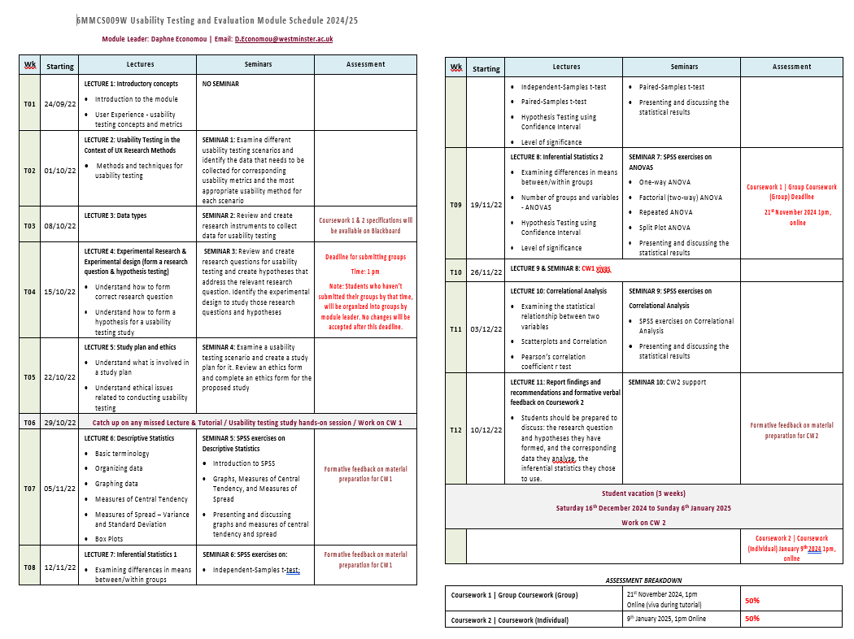
Module Schedule
[Access the module schedule on Blackboard | Welcome and Module Handbook]

Slide 8
Assessment
Students will not be considered to have passed this module if their mark in either of the above components is less than 40%.
Unit | Weight | Description | Submission Deadline
Group coursework | 50% | Group coursework - assesses the students’ skills in: forming a research question, organising, planning and conducting user testing and collecting data that help addressing the research question. LO1-LO3. | 21st November 2025, 1pm Online (viva during tutorial)
Individual coursework | 50% | Individual coursework - assesses the students’ skills in: using statistical packages to organise data that has been collected to address a usability testing research question; selecting appropriate statistical methods to analyse the data; reporting usability testing findings and making recommendations to improve the usability of a digital product. LO4-LO5. | 9th January 2026, 1pm Online (no viva)

Slide 9
Module information
Notes
  all projections and material accompanying the lectures and the tutorials will be distributed via
  blackboard https://learning.westminster.ac.uk/ultra/courses/_103122_1/outline
Queries
  should be solved at an early stage
  if any problems come and see the module leader or your tutor

Slide 10
Reading List [Check the Reading list on Blackboard]
Thomas Tullis, William Albert (2022) Measuring the User Experience: Collecting, Analyzing, and Presenting UX Metrics, Morgan Kaufmann [Online resource]
Carol M. Barnum (2020) Usability testing essentials, Ready, Set... Test!, Morgan Kaufmann, [Online resource]
Jeffrey Rubin, Dana Chisnell (2008) Handbook of Usability Testing: How to Plan, Design, and Conduct Effective Tests, Wiley [Online resource]
Dr. Jonathan Lazar, Dr. Jinjuan Heidi Feng, Dr. Harry Hochheiser (2017) Research Methods in Human-computer Interaction, Wiley.
Marc Brysbaert (2011) Basic statistics for psychologists, Basingstoke : Palgrave Macmillan, ISBN9780230275423
Liam Foster, Ian Diamond & Julie Jefferies (2014) Beginning statistics : an introduction for social scientists, SAGE, 1446280705.
J., Preece, Y., Rogers & H., Sharp (2019) Interaction Design, beyond human computer interaction, 5th Edition, Wiley [Online resource]

